Slide 1
NAAN MUDHALVAN PROJECT
STUDENT NAME : MYTHILI.D
REGISTER NO : 312215418
DEPARTMENT : ACCOUNTING & FINANCE
COLLEGE : PATRICIAN COLLEGE OF ARTS & SCIENCE

Slide 2
PROJECT TITLE
EMPLOYEE DATA ANALYSIS USING EXCEL

Slide 3
AGENDA
Problem Statement
Project Overview
End Users
Our Solution and Proposition
Dataset Description
WoW in our Solution
Modelling
Results
Conclusion

Slide 4
PROBLEM STATEMENT
I have a doubt that, wether Women getting equal salary to Men.So this Project helps to clarify my Doubt. So i am doing this project. Also i want to know about the Age and Experiencedifference between Employees in an Organization.

Slide 5
PROJECT OVERVIEW
In this Project i am going to findout whether Men and Women are getting equal Salary & the age and experience difference. For that I will findout the salary of Men & Womn and see whether they are getting equal or there is a difference. To findout the age & experience, i will separate people into different categories and findout the difference.

Slide 6

WHO ARE THE END USERS?
The End Users for my Project are Employer and Employee

Slide 7
OUR SOLUTION AND ITS VALUE PROPOSITION
To Find out the Answer for my question, i collected a dataset of employees with information regarding thier Age, Experience, Salary Of Both Male and Female. I will be using various Functions of MS - EXCEL so that i can find the salary of Mne and Women.

Slide 8
DATASET DESCRIPTION
Features Of DataSet:
ID
GENDER
AGE
EXPERIENCE
SALARY
The Dataset has been Extracted from Kaggle

Slide 9
THE “WOW” IN OUR SOLUTION
FUNCTIONS AND FORMULAS
DATA ANALYSIS AND VISUALIZATION
ORGANIZING AND FORMATTING WORKSHEETS
SHORTCUTS AND PRODUCTIVITY TIPS
SOLVING PROBLEMS AND CHALLENGES

Slide 10
MODELLING
a) MS EXCEL:
Microsoft Excel Enables users to format, organize and calculate data in spreadsheet. By organizing data using software like Excel, data analyst and other users can make information easier to view as data is added or changed.
b) Average Function:
The average function is a statistical function that calculates the airethmetic mean of a range of numbers. It can be used to find the average of total sales, exam scores etc.

Slide 11
c) Sorting Function:
Sorting helps to organize Data. You can sort a text column in alphabetical order (A - Z or Z - A). We can sort a numercial from largest to smallest or smallest to largest. We can also Sort Date and time.
d)Filter Function:
Filter is an essential tool helps to display relevant Data. It eliminates the irrelevant entries temporarily from the view. This tool filters data according to the criteria to help analyze the critical data points.

Slide 12
e) Kaggle:
Kaggle is a subsidiary of Google. It is an online community of data scientist and machine learning engineers. It allows users to find datasets they want to use in building AI models, publish datasets, work with other data scientist and machine learning engineers and enter competetions to solve data science challenges.

Slide 13
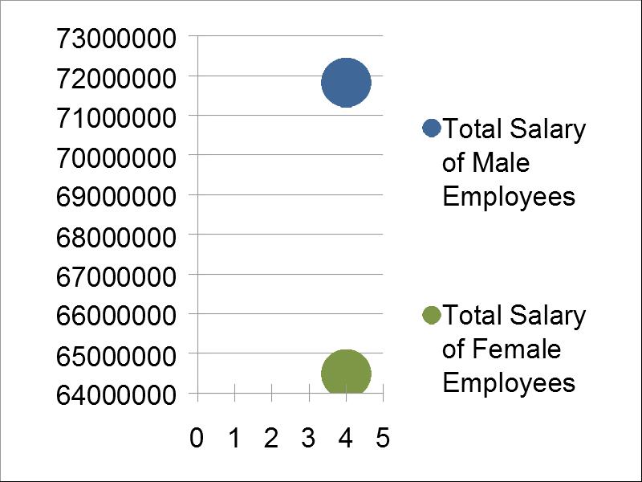
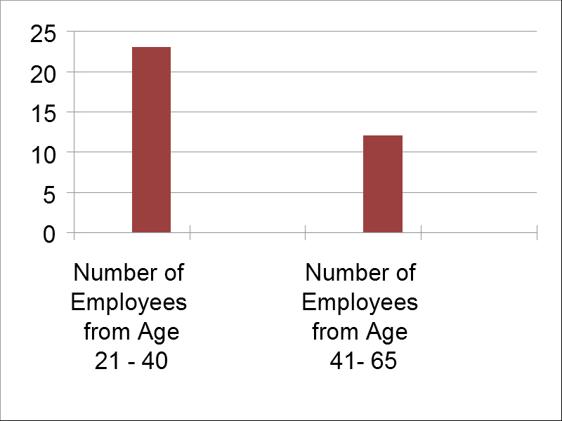
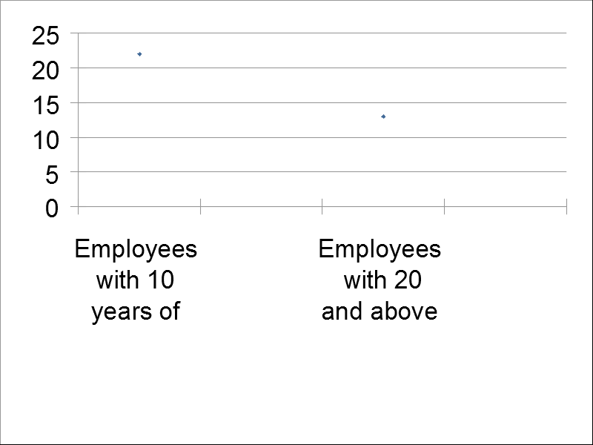
RESULT

Slide 14
CONCLUSION
It has been found out that there is no equal pay between men and women. There has been a difference of around 70,00,000. It isnt good for the climate of the organization. Women employees might be mentally affected if they don’t get equal pay to men. There should be equal payroll between Men and Women.

